Slide 1

Introduction to Machine Learning & Deep Learning
Nikesh Bajaj, PhD Research Associate Imperial College London http://nikeshbajaj.in
https://spkit.github.io/tutorials

Slide 2
Agenda
Introduction
What is (Machine) Learning?
Types of Machine Learning Problems
Supervised Learning
Regression
Classification
Excercises and examples
Performance metrics
Deeplearning
Neural Networks
Examples
Conclusion + Resouces

Slide 3
About me …
Current work
PhD Work
What I like about Machine Learning and AI
Activities
Consultant with deeplearning.ai
Mentor at Coursera
Competitions, Study groups, Certifications and Courses

Slide 4
What is (machine) learning?
Intelligent Systems
Data Analysis/Science or Statistical Analysis
- A way to design intelligent systems using data
- Early intelligent systems and algorithms were build by hand crafted rules.
- Designing a machine that learn from given data. Without hardcoding the rules.

Slide 5
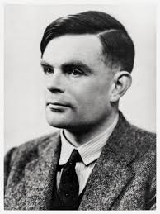
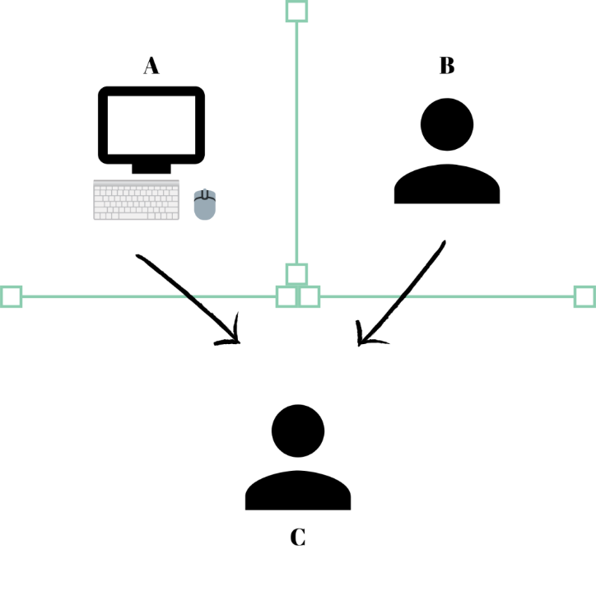
Artificial Intelligence
Fields in Artificial Intelligence
Computer Vision
Robotics
Natural Language Processing
Speech/Audio Processing
Knowledge/Data Representation
Machine Learning
.
.
Examples (classical)
Automatic face tagging
Speech to text, Translation
Face/emotion recognition
Sentiment analysis
Music classification
Movie/product recommendation
Search engine
IoT
… many more
Turing Test

Slide 6




How do we do that?
Computer(s)
Data (signal)

Slide 7
How do you know, if it is working?
A machine is said to learn from experience E, with respect to task T and some performance measure P, if machine improves on task T, as measured by P, with respect to experience E. (Tom Mitchell (1998))*.
Properly formulating the a problem and choosing a performance measure
One of the common mistakes that I encounter, that people overlook above definition or work with poorly formulated problem
Good News: A lot of people, in this field have already done this part for you. You can start from textbook examples to well defined problems and performance measures.
* from Coursera

Slide 8
Machine Learning Problems
Supervised Learning
We know what we are looking for
Unsupervised Learning
We want to find something meaningful
Semi-supervised learning
Weakly supervised learning
Reinforcement Learning & Recommender systems

Slide 9
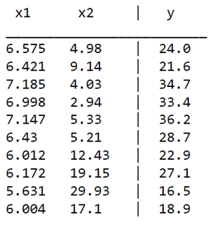
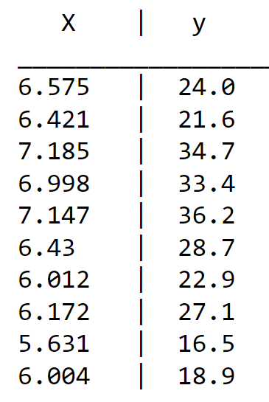
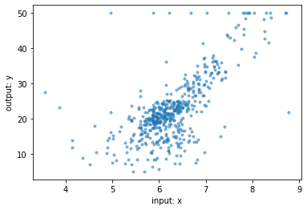
Supervised Learning
system
X
y
Given data – X, and corresponding target value – y, think it as X,y problem. “X maps to y”
Examples: Boston House price*
X ∈ R^{n}
*from scikit-learn

Slide 10
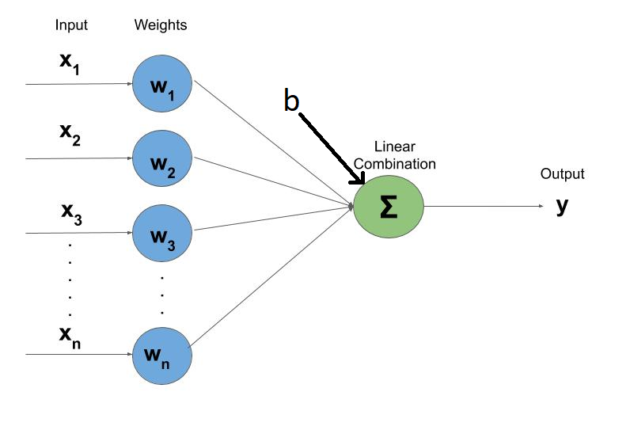
Supervised Learning
Using LMS
Using Gradient Decent
Let’s try LMS
Problem (simplified way):
Given X, y
Find a function f, such that y = f(X)
f: can be any function, linear, non-linear, etc
Example: a linear function
y’ = f(X)
y’ = b + w₁x₁ + w₂x₂ . . . w_{n}x_{n}
Optimise parameters w
Such that y’ ≈ y, close enough*
This is simply an optimisation problem
f(x)
X
y
Is it enough??

Slide 11
Supervised Learning
f(x)
X
y
Difference between Learning and memorising
A simple choice: f can be a look-up table, a perfect mapping of X to y
Issue: wouldn’t know what to do with new values of X (unseen data - X_{u})
Not so simple choice: f can be a very large and complex function (e.g. deeeeep neural network). Is it good?
Issue: lack of generality, wouldn’t do good on unseen data X_{u} : Overfitting

Slide 12
Supervised Learning
Solution: Problem (properly)
For given X, y, find function f as to
Estimate/predict y’ = f(X)
Such that:
min E[L(y’_{u} , y_{u} )]
for unseen data X_{u}
L(y’_{u} , y_{u}): Estimated risk / Loss
Training data : Data used to find optimise parameters
Testing data: Unseen data, used to evaluate the model (function) performance

Slide 13
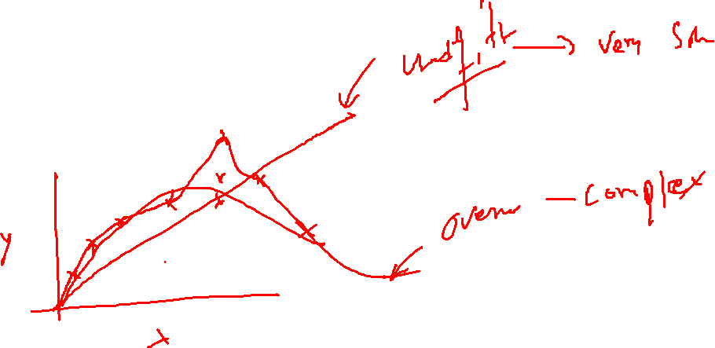

Slide 14
How does that work?
We split data (X, y) randomly to two sets
Training set (Xt, yt)
Testing set (Xs, ys)
How much to split?
Does this work?
What can go wrong?
Other strategies:
.. K-Fold cross validation, LOOV,
.. (train, validation/dev, test)

Slide 15
Regression & Classification
Question: Can we treat classification problem as regression??
Supervised Learning: Regression & Classification
Regression:
- target (y) is continues variable y ∈ R
- Example
Target: Housing price, blood sugar, temperature,
Classification:
- target (y) is categorical, or limited set of integers y ∈ [0, 1]
- Examples:
Email-spam or not, cat & dog image, handwriting digits classification, Cancer or not etc

Slide 17
Performance Measure & Loss function
Regression:
Mean Square Error, L(y’, y) = E [ |y’-y|² ]
Mean Absolute Error L(y’, y) = E [ |y’-y| ]
R^2, Pearson correlation
Classification:
Accuracy, E[(y’==y)]
F1-score, precision, recall, AUC
Diagnosis: Confusion Matrix, ROC, misclassification, learning curve (NN)
Loss function: Cross-entropy, Hinge loss, logistic loss etc
Why so many measures?

Slide 18
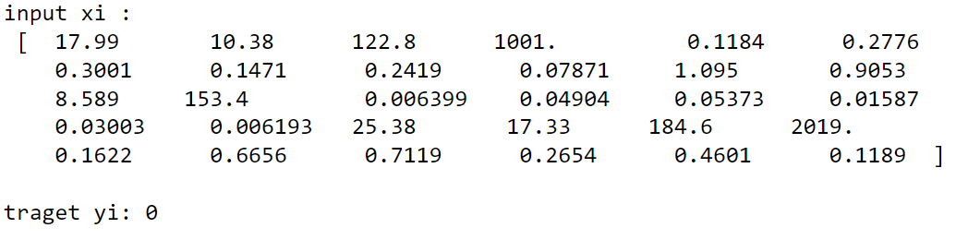
Classification Problem
Example: Binary Classification
Breast cancer Classification:
target y ∈ [ 0, 1]
30 features: X:
Can we apply linear regression model?
Kind-of, yes* and No*, until it is binary

Slide 19
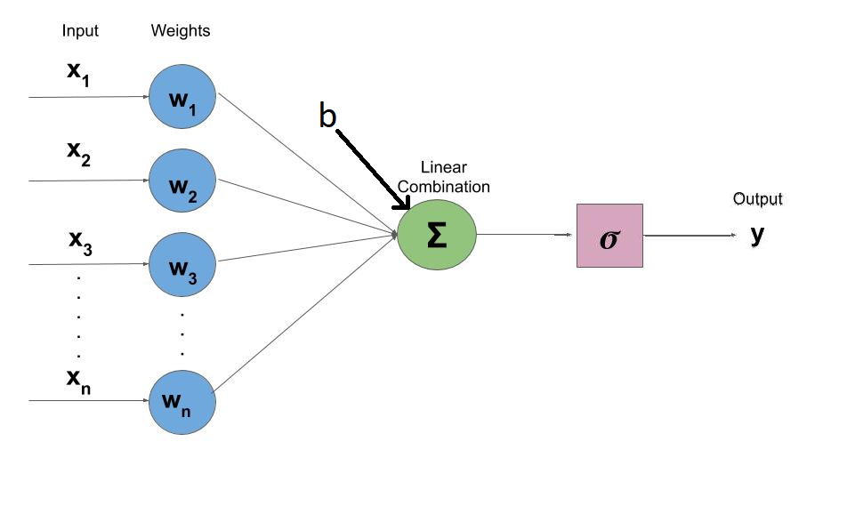
Classification Problem
Binary Classification:
h = b + w₁x₁ + w₂x₂ . . . w_{n}x_{n}
_{y = 1 if h>0 else 0}
_{How far h should be from 0?}
_{As far as possible}
y_{p} = sigmoid(h)

Slide 20
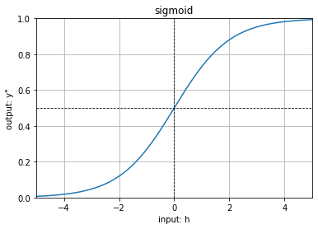
Classification Problem
Binary Classification:
yp = sigmoid(h) = 1/ (1 + exp(-h))
Loss L(y,y_{p}) = ylog(y_{p}) + (1-y)log(1- y_{p})

Slide 21
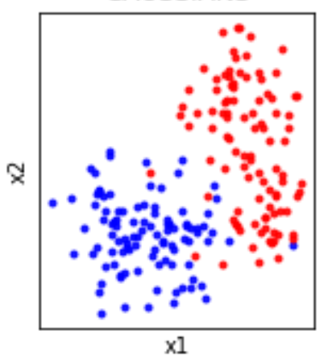
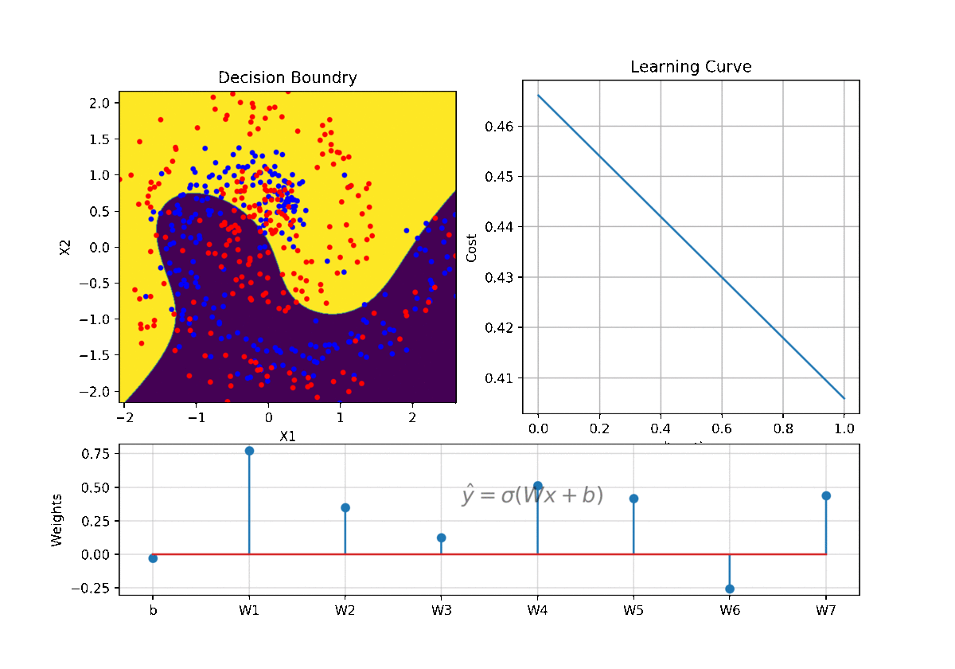
Classification Problem
Binary Classification:
h = b + w₁x₁ + w₂x₂
We need, h, a plane, in hyperdimensional space that separates two classes

Slide 22

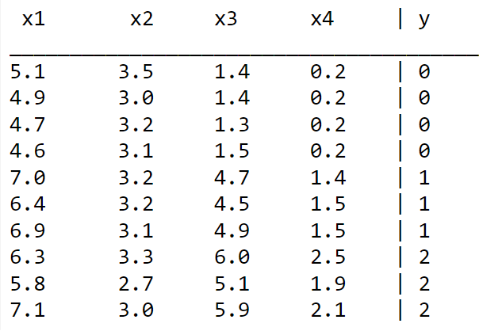
Classification Problem
Example: Iris Dataset
Features:
x1: sepal length (cm)
x2: sepal width (cm)
x3: petal length (cm)
x4: petal width (cm)
Three classes:
Setosa, Versicolor, Virginica
0 1 2

Slide 23
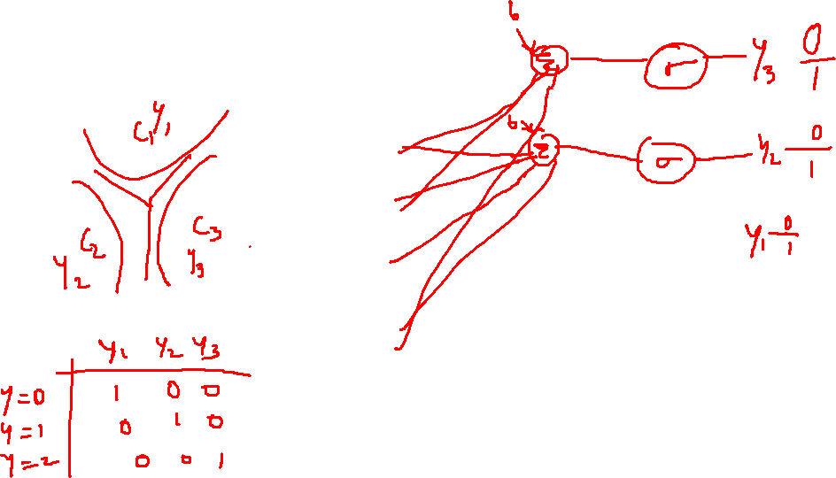
Classification Problem
Iris dataset – Multi-class
- How do we do it?
- one vs all

Slide 24

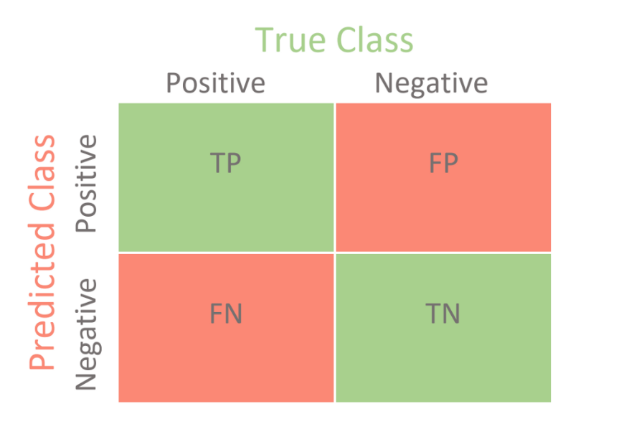
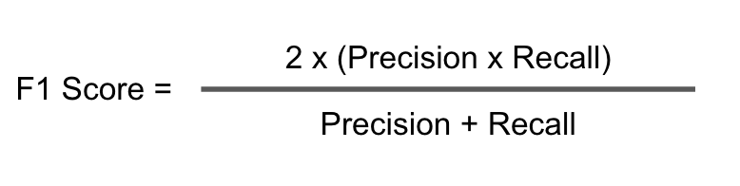
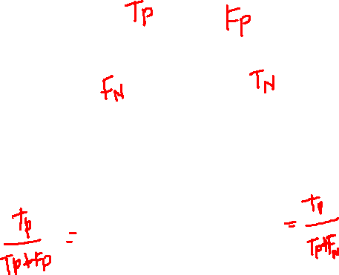
Performance Metrics
*Wikipedia

Slide 25
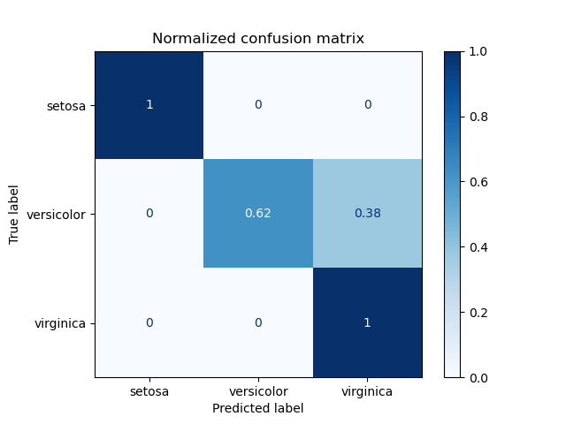
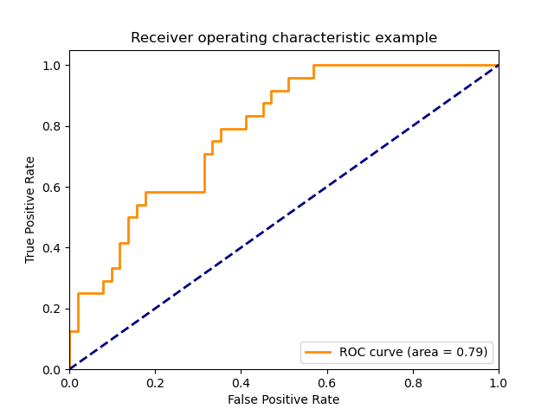
Performance Metrics
Confusion matric is not always same as TP/FP table

Slide 26
Normalising Features
Normalising :
When?
Why?
How?
- Mean cantered: Zero-mean, remove DC
Scale Standard Deviation
0-1 normlisation

Slide 27
Machine Learning Models
ML Models:
Linear regression, Logistic Regression
Support Vector Machine
Decision Tree
K-Nearest Neighbourhood (KNN)
Naïve Bayes
Ensemble Approach:
Random Forest
Gradient Booster
ExtraTree, AdaBoost

Slide 28
Logistic Regression

Slide 29
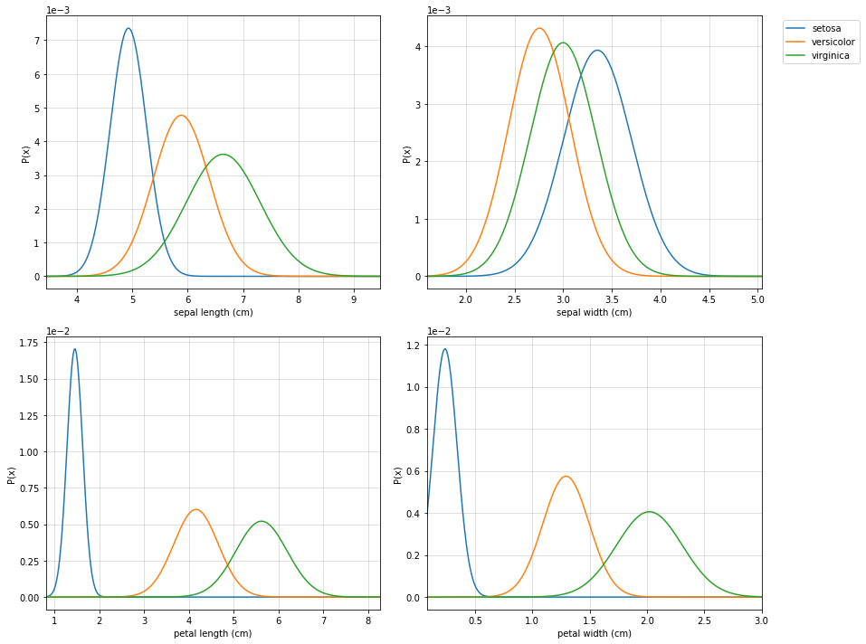
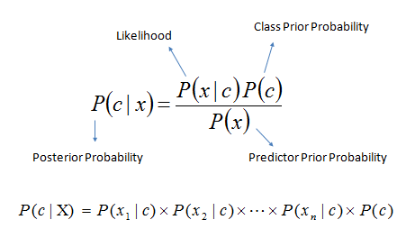
Naïve Bayes

Slide 30
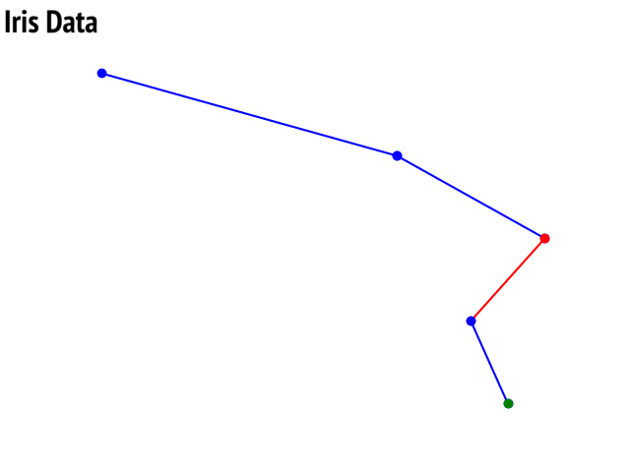
Decision Trees

Slide 31
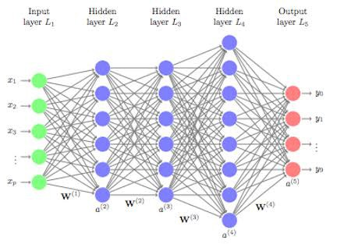
Neural Network - Idea

Slide 32
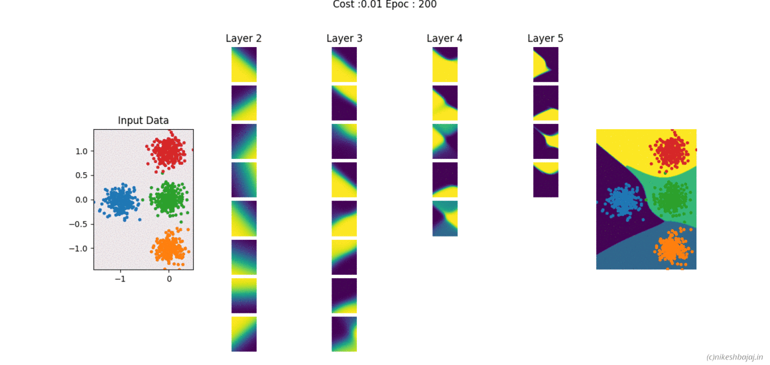
Neural Network

Slide 33
Deeplearning
Deeplearning
The deep* learning refer to a family of models based on Neural Networks. It has following aspects w.r.t conventional ML models
End-to-end learning
Complex relationship of input-target
Proven to solve many problems, which were not easy with conventional ML
Large number of parameters, heavy,
Not as easy to explain as conv. ML models

Slide 34
Deeplearning
Neural Network:
Fully Connected Neural Network (MLP)
Convolutional Neural Network (CNN)
Recurrent Neural Network (RNN) – LSTM, GRU
Generative Adversarial Networks (GANs)

Slide 35
Example
Handwritten Digit Recognition :

Slide 37

Any Questions ?
https://nikeshbajaj.in

